Slide 1







POWER BI
Presented by : Tanaya Narvekar

Slide 2



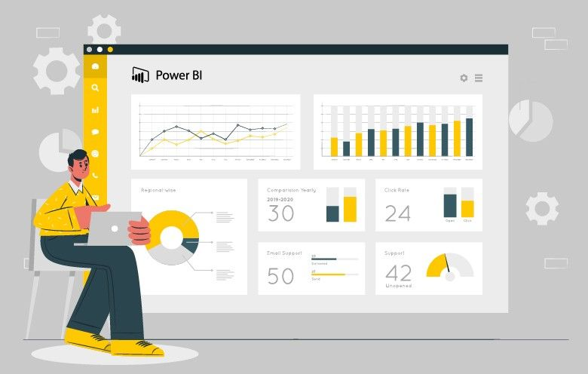

INTRODUCTION
POWER BI is a reporting tool used to create interactive reports.
It enables users to visualize data, share insights across an organization, or embed them in an app or website.
POWER BI is a Microsoft Business Intelligence tool that offers data connectivity, interactive visualizations, data transformation with power query, cloud-based sharing, etc.
POWER BI updated every month with new features.

Slide 3

POWER BI WORKS IN 4 PHASES
VISUALIZATION PHASE
The visual building phase is where you create charts, graphs and dashboards to show your data in a clear and interactive way.
GET DATA PHASE
It is the first step where you bring data into POWER BI from different sources.
MODEL BUILDING PHASE
The model building phase is where you organize and relate your data so that POWER BI can understand how everything connects.
MODEL ENHANCEMENT PHASE
The model enhancement phase is where you improve your data model to make reports more useful, faster and easier to understand.

Slide 4
FOUR VIEWS IN POWER BI
MODEL VIEW
Shows how your tables are connected(relationships).
DAX QUERY VIEW
It is a window where you can write and run DAX(Data Analysis Expressions)queries.
REPORT VIEW
This is where you design your dashboards and reports.
TABLE VIEW
Lets you see your data in table form , like a spreadsheet.

Slide 5
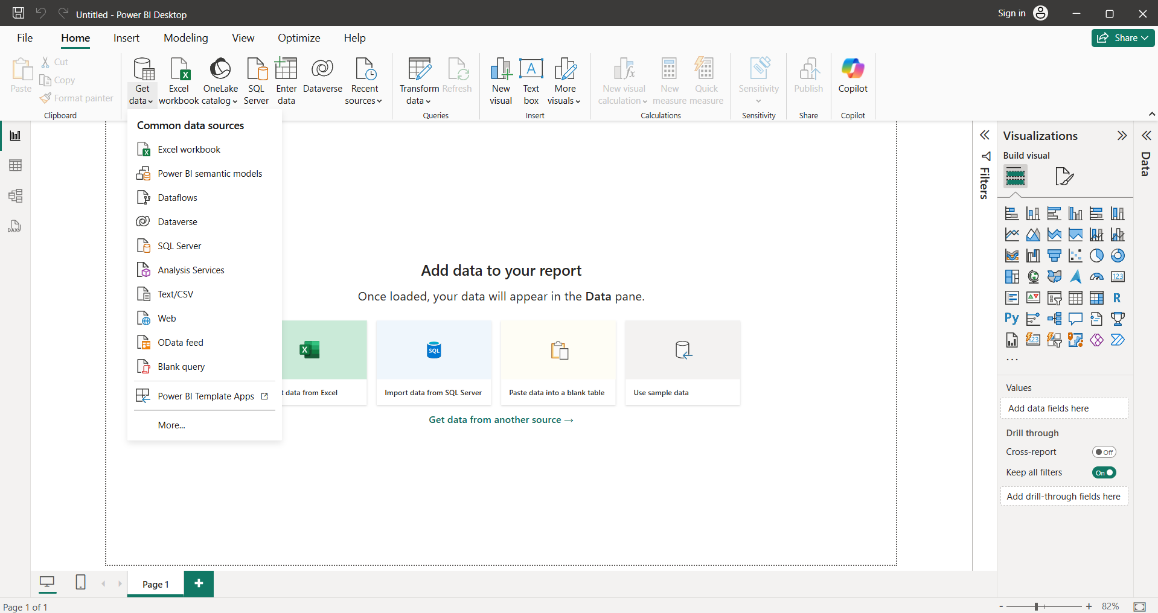
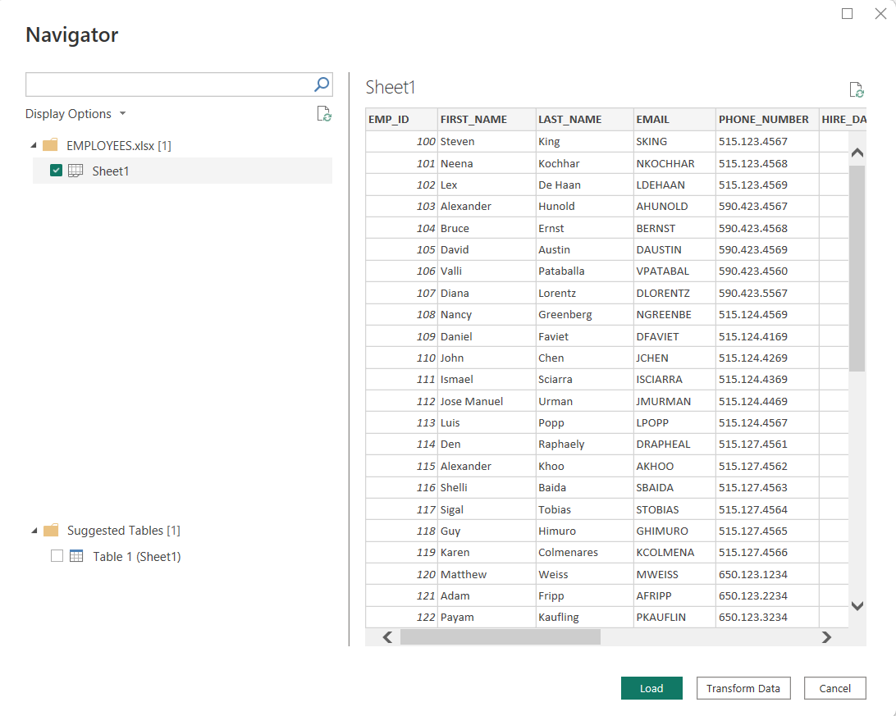
GET DATA PHASE

Slide 6
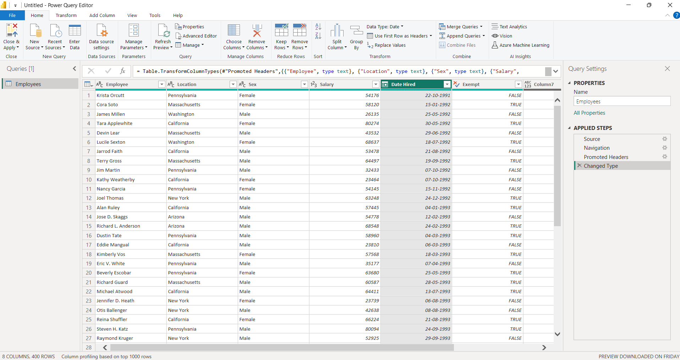
POWER QUERY EDITOR
POWER QUERY EDITOR is used to perform ETL on data before using it in reports and dashboards.

Slide 7
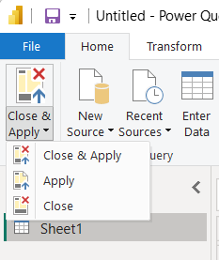
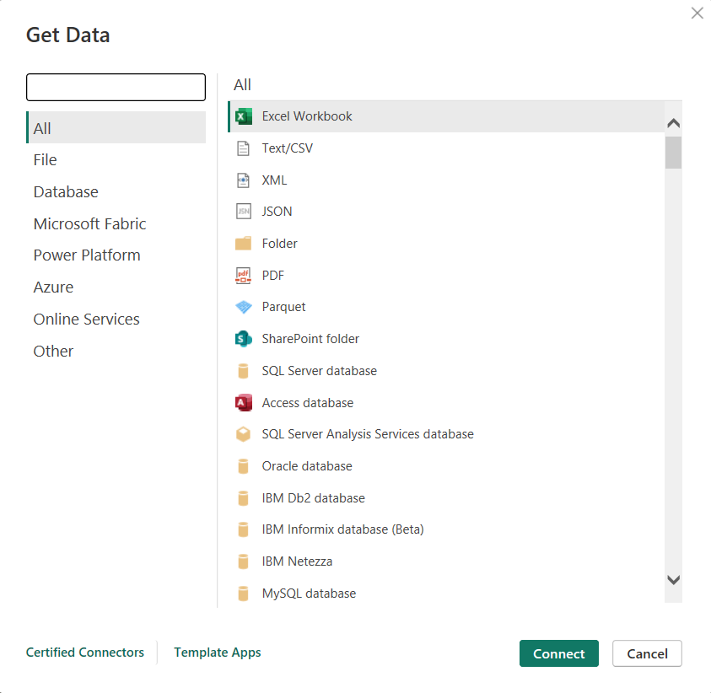
HOME
CLOSE AND APPLY
CLOSE AND APPLY : APPLY THE CHAGES AND THEN CLOSE THE WINDOW.
APPLY : ONLY APPLY THE CHANGES WITHOUT CLOSING THE WINDOW.
CLOSE : CLOSE THE POWER QUERY EDITOR WINDOW.
NEW SOURCES
IT IS USED TO ADD NEW DATA SOURCES TO YOUR REPORT WHILE YOU ARE ALREADY IN THE QUERY EDITING ENVIRONMENT.
POWER QUERY EDITOR
HOME

Slide 8
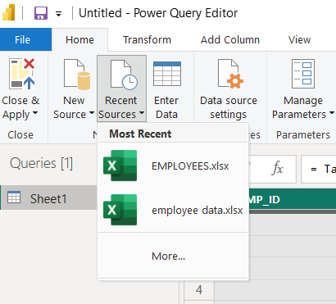
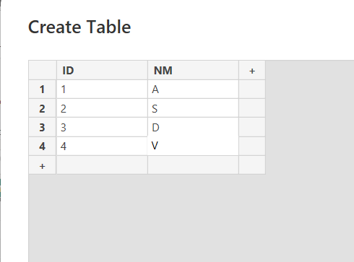
POWER QUERY EDITOR
HOME
RECENT SOURCES
THIS OPTION ALLOWS TO QUICKLY ACCESS DATA SOURCES THAT YOU HAVE PREVIOUSLY CONNECTED TO.
ENTER DATA
IT ALLOWS YOU TO MANUALLY CREATE A NEW TABLE BY TYPING IN DATA DIRECTLY - SIMILAR TO ENTERING DATA IN AN EXCEL SPREADSHEET.

Slide 9
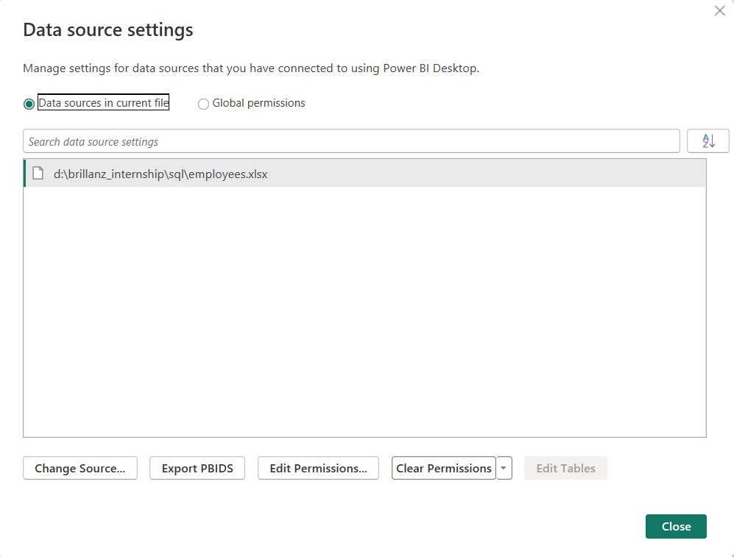
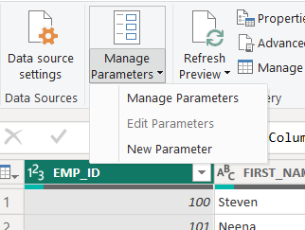
POWER QUERY EDITOR
HOME
DATA SOURCE SETTING
IT ALLOWS YOU TO MANAGE THE CONNECTIONS TO YOUR DATA SOURCES – INCLUDING CREDENTIALS , PRIVACY LEVELS AND SOURCE PATHS.
MANAGE PARAMETERS
IT IS UESD TO CREATE , EDIT AND MANAGE PARAMETERS THAT CAN MAKE YOUR QUERIES DYNAMIC AND REUSABLE.

Slide 10
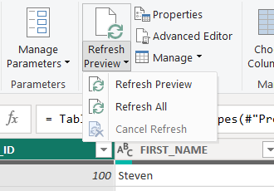
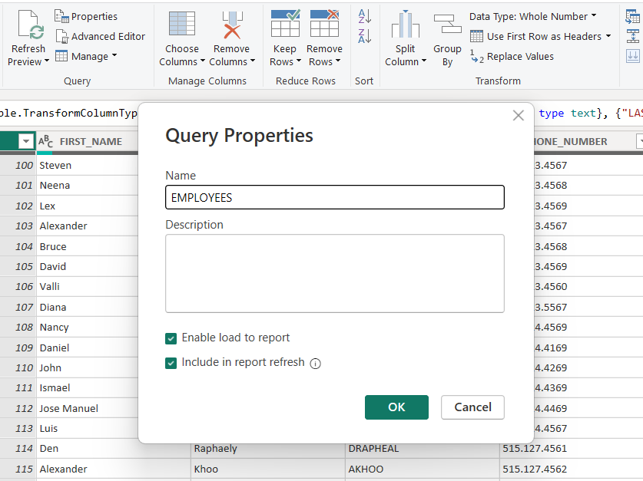
POWER QUERY EDITOR
HOME
REFRESH PREVIEW
REFRESH PREVIEW : REFRESH THE PREVIEW RESULTS FOR THIS QUERY.
REFRESH ALL : REFRESH THE PREVIEW RESULTS FOR ALL QUERIES.
CANCLE REFRESH : CANCLE THE REFRESHING OF THE QUERY.
PROPERTIES
IT IS ALLOWS YOU TO RENAME A QUERY AND OPTIONALLY ADD A DESCRIPTION TO IT.

Slide 11
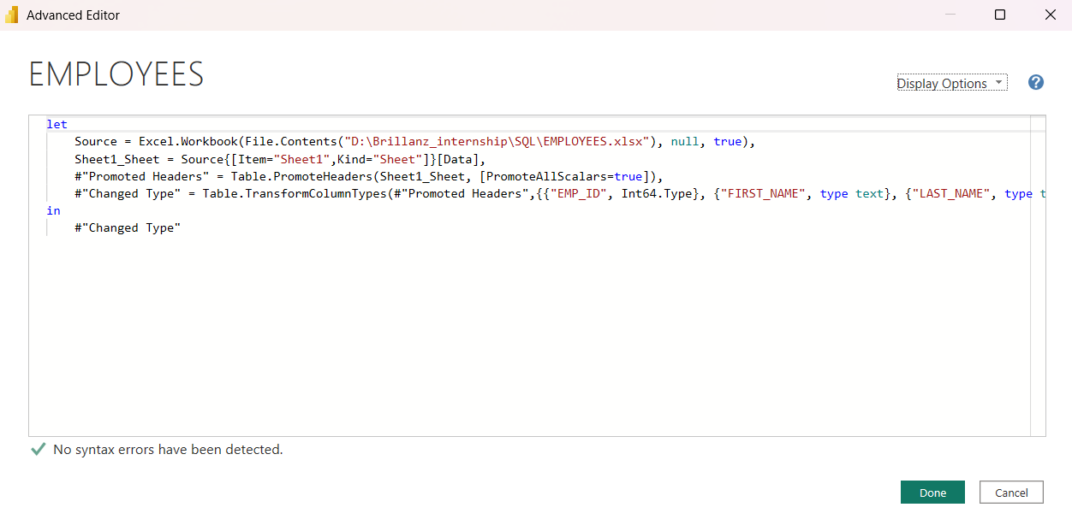
POWER QUERY EDITOR
HOME
ADVANCED EDITOR
IT LET YOU VIEW AND EDIT THE FULL M CODE BEHIND A QUERY
M QUERY STANDS FOR MASHUP QUERY WHICH IS FUNCTIONAL LANGUAGE BEHIND POWER QUERY.
EVERY TRANSFORMATION YOU APPLY IN THE POWER UI IS TRANSLATED INTO M CODE , WHICH DEFINES STEP-BY-STEP HOW YOUR DATA IS LOADED , TRANSFORMED AND PREPARED.

Slide 12
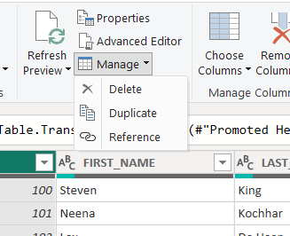
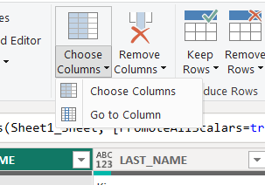
POWER QUERY EDITOR
HOME
MANAGE
DELETE : REMOVES THE SELECTED QUERY FROM YOUR QUERIES PANE.
DUPLICATE : CREATES THE COPY OF THE SELECTED QUERY.
REFERENCE : CREATES A NEW QUERY THAT REFERS TO THE RESULT OF THE SELECTED QUERY.
CHOOSE COLUMNS
CHOOSE COLUMNS : OPEN A DIALOG WHERE YOU CAN MANUALLY SELECT WHICH COLUMNS TO KEEP IN THE QUERY.
GO TO COLUMNS : HELPS YOU TO JUMP TO A SPECIFIC COLUMN IN WIDE TABLES WITH MANY FIELDS.

Slide 13
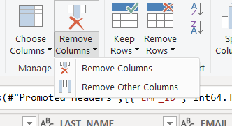
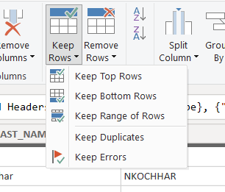
POWER QUERY EDITOR
HOME
REMOVE COLUMNS
REMOVE COLUMNS : REMOVE ONLY THE SELECTED COLUMN FROM THE TABLE.
REMOVE OTHER COLUMNS : KEEPS ONLY THE SELECTED COLUMN AND REMOVES ALL OTHERS
KEEP ROWS
KEEP TOP ROWS : KEEP THE FIRST N ROWS OF THE DATASET.
KEEP BOTTOM ROWS : KEEP THE LAST N ROWS OF THE DATASET.
KEEP RANGE OF ROWS : KEEPS A SPECIFIC NUMBER OF ROWS STARTING FROM A PARTICULAR ROW INDEX.
KEEP DUPLICATES : KEEP ONLY ROWS THAT HAVE DUPLICATE VALUES IN A SELECTED COLUMNS.
KEEP ERRORS : KEEPS ONLY ROWS THAT CONTAIN ERRORS IN ONE OR MORE COLUMNS.

Slide 14
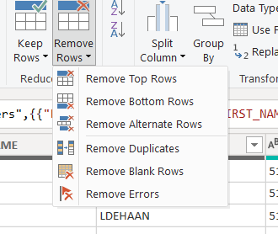
POWER QUERY EDITOR
HOME
REMOVE ROWS
REMOVE TOP ROWS : REMOVE THE FIRST N ROWS OF THE DATASET.
REMOVE BOTTOM ROWS : REMOVE THE LAST N ROWS OF THE DATASET.
REMOVE ALTERNATE ROWS : IT ALLOWS YOU TO DELETE ROWS IN A REPEATING PATTERN , SUCH AS EVERY SECOND AND THIRD ROW.
REMOVE DUPLICATES : REMOVE ONLY ROWS THAT HAVE DUPLICATE VALUES IN A SELECTED COLUMNS.
REMOVE BLANK ROWS : IT REMOVE ROWS WHERE ALL COLUMNS ARE BLANK OR NULL.
REMOVE ERRORS : REMOVES ONLY ROWS THAT CONTAIN ERRORS IN ONE OR MORE COLUMNS.

Slide 15
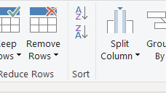
POWER QUERY EDITOR
HOME
SORT
IT ALLOWS YOU TO ORDER ROWS BASED ON ONE OR MORE COLUMNS , EITHER ASCENDING OR DESCENDING.
IT SORTS RECORDS BASED ON SELECTED COLUMNS.
THIS HELPS ORGANISE YOUR DATA BEFORE LOADING IT INTO POWERBI.

Slide 16
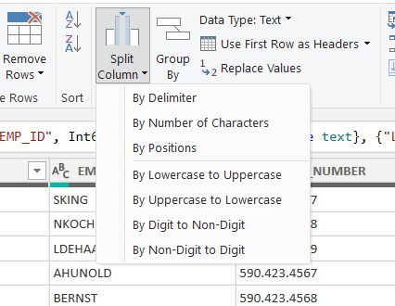
SPLIT COLUMN
BY DELIMITER : USED WHEN YOUR COLUMN HAS A CHARACTER LIKE A COMMA , SPACE , OR DASH SEPERATING VALUES.
BY NUMBER OF CHARACTERS : USED WHEN YOU WANT TO SPLIT THE COLUMN EVERY FEW LETTERS OR NUMBERS.
BY POSITIONS : USED WHEN YOU WANT TO SPLIT AFTER A SPECIFIC POSITIONS.
BY LOWERCASE TO UPPERCASE : USED WHEN A LOWERCASE LETTER IS FOLLOWED BY AN UPPERCASE LETTER. FOR EX. “helloWorld” -> “hello” AND “World”.
BY UPPERCASE TO LOWERCASE : USED WHEN A UPPERCASE LETTER IS FOLLOWED BY AN LOWERCASE LETTER. FOR EX. “HELLOworld” -> “HELLO” AND “world”.
BYDIGIT TO NON-DIGIT : USED WHEN A NUMBER IS FOLLOWED BY A LETTER. FOR EX. “123ABC” -> “123” AND “ABC”.
BY NON-DIGIT TO DIGIT : USED WHEN A LETTER IS FOLLOWED BY A NUMBER. FOR EX. “ABC123” -> “ABC” AND “123”.
POWER QUERY EDITOR
HOME

Slide 17
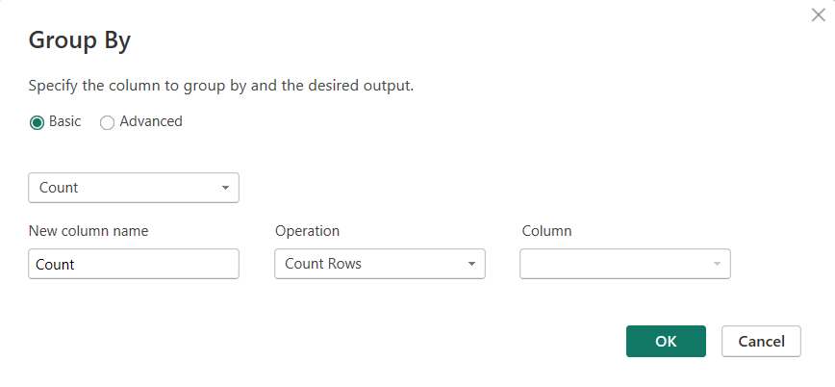
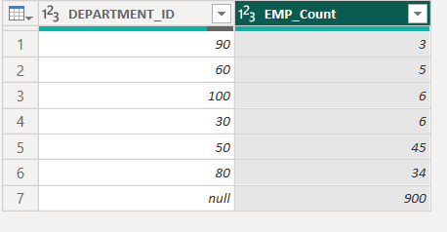
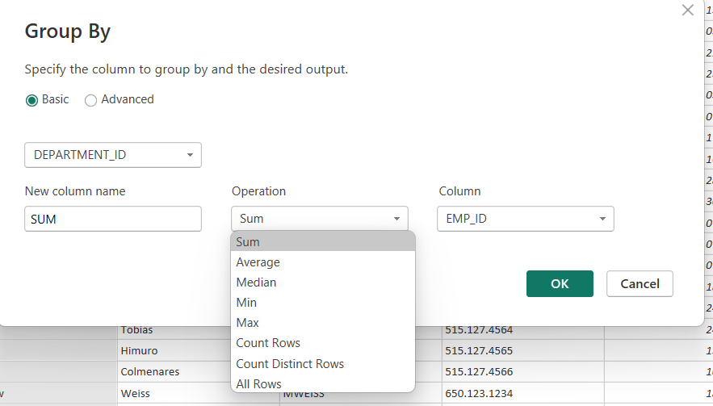
GROUP BY
IT IS USED TO GROUP ROWS THAT HAVE THE SAME VALUES IN ONE OR MORE COLUMNS AND THEN APPLY A AGGREGATE FUNCTIONS LIKE SUM , COUNT , AVG , ETC.
POWER QUERY EDITOR
HOME

Slide 18
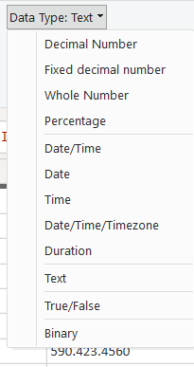
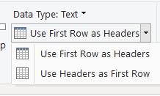
POWER QUERY EDITOR
HOME
DATATYPE
A DATA TYPE TELLS POWER BI WHAT KIND OF DATA IS IN EACH COLUMNS.
USE FIRST ROW AS HEADERS
USE FIRST ROW AS HEADERS : PROMOTES THE FIRST ROW OF THIS TABLE INTO COLUMN HEADERS.
USE HEADERS AS FIRST ROW : DEMOTES THE HEADERS OF THIS TABLE TO THE FIRST ROW.

Slide 19
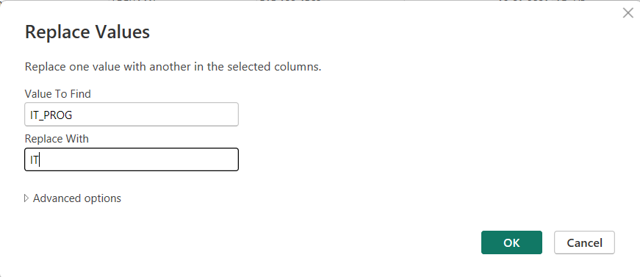
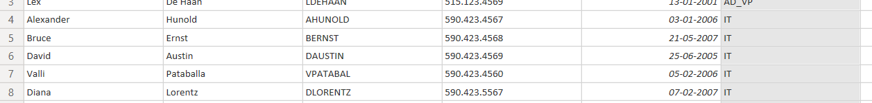
POWER QUERY EDITOR
HOME
REPLACE VALUES
THIS LETS YOU FIND SPECIFIC TEXT OR NUMBERS IN A COLUMN AND CHANGE THEM TO SOMETHING ELSE.

Slide 20
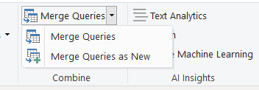
POWER QUERY EDITOR
HOME
MERGE QUERIES
IT COMBINES TWO TABLES BASED ON A COMMON COLUMNS.
ITS ACT LIKE A JOINS IN SQL.
MERGE QUERIES : IT COMBINES TWO TABLES DIRECTLY INTO THE CURRENT TABLE YOU’RE WORKING ON.
MERGE QUERIES AS NEW : CREATING NEW TABLE AS A RESULT OF A MERGE WITHOUT CHANGING THE ORIGINAL TABLE.
IN POWER BI , NULL = NULL

Slide 21
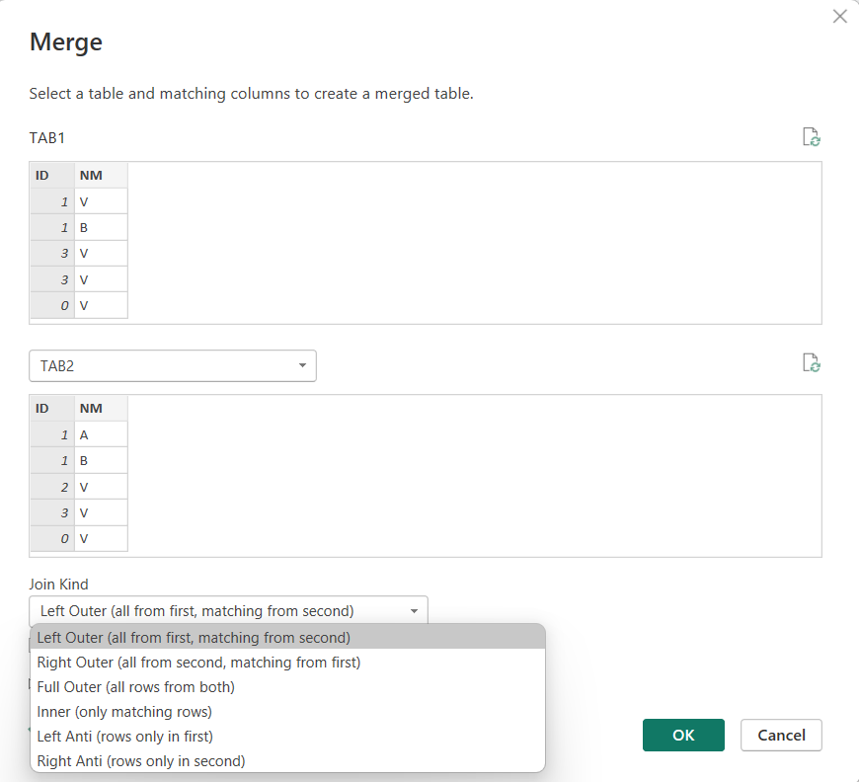
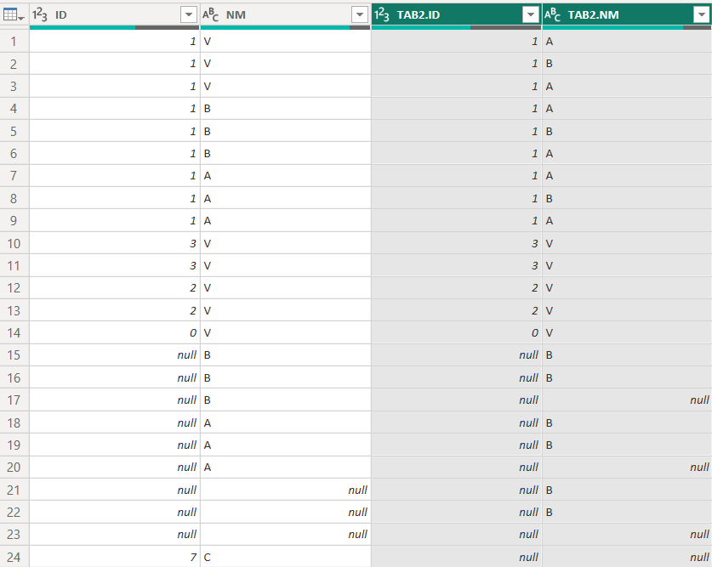
POWER QUERY EDITOR
HOME
SELECT THE TABLE WHICH YOU WANT TO MERGE.
THEN SELECT A SAME COLUMNS OF BOTH THE TABLES.
SELECT TYPE OF JOIN.
AND THEN CLICK ON OK TO MERGE THE COLUMNS OF A TABLES.

Slide 22
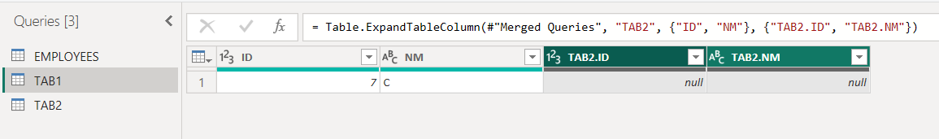
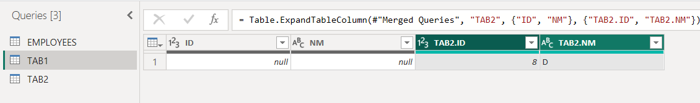
POWER QUERY EDITOR
HOME
LEFT ANTI : IT DISPLAY FIRST TABLE ROWS WHICH ARE NOT PRESENT IN SECOND TABLE (UNIQUE ROWS).
RIGHT ANTI : IT DISPLAY SECOND TABLE ROWS WHICH ARE NOT PRESENT IN FIRST TABLE.

Slide 23
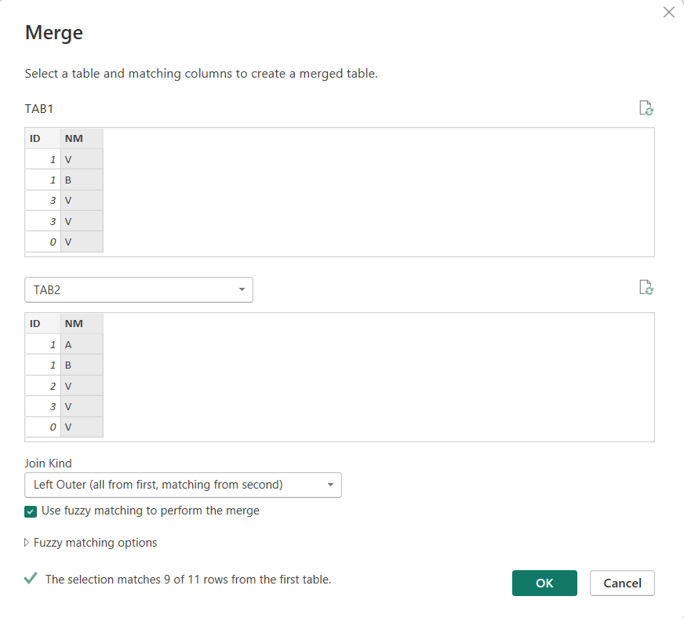
USE FUZZY MATCHING TO PERFORM THE MERGE
POWER QUERY EDITOR IS CASE SENSITIVE MEANS “Apple” and “apple” ARE TREATED AS DIFFERENT VALUES.
IN MERGE QUERIES , YOU CAN ENABLE “IGNORE CASE” IN THE FUZZY MATCHING SETTINGS.
THIS TELLS POWER BI TO TREAT “Apple” AND “apple” AS THE SAME.
POWER QUERY EDITOR
HOME

Slide 24
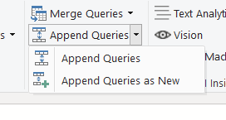
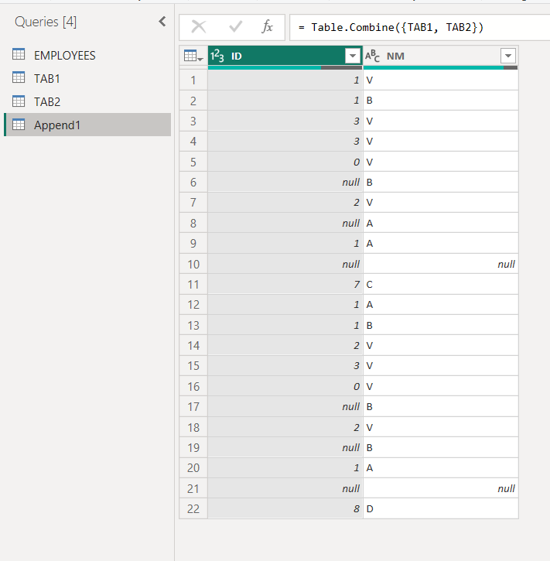
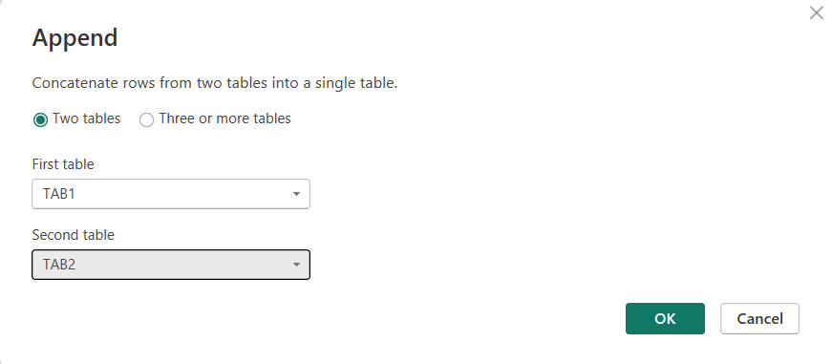
APPEND QUERIES
IT IS USED TO COMBINE ROWS FROM TWO OR MORE TABLES.
ITS ACT LIKE A UNION ALL (SET OPERATOR) IN SQL.
IT ADDS ONLY THOSE ROWS WHICH COLUMNS CONTAINS SAME NAME WITH SAME DATA TYPE.
APPEND QUERIES : ADD ROWS FROM ONE TABLE INTO THE CURRENT TABLE.
APPEND QUERIES AS NEW : COMBINES THE TABLES INTO A NEW TABLE.
POWER QUERY EDITOR
HOME

Slide 25
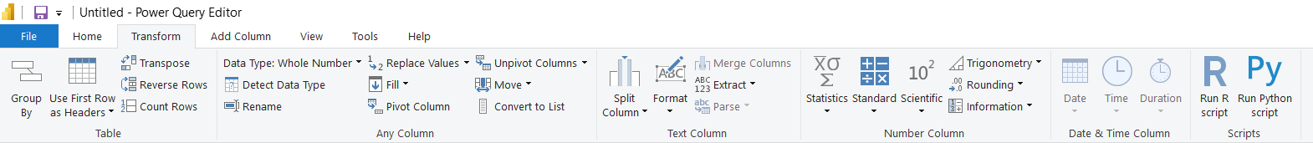
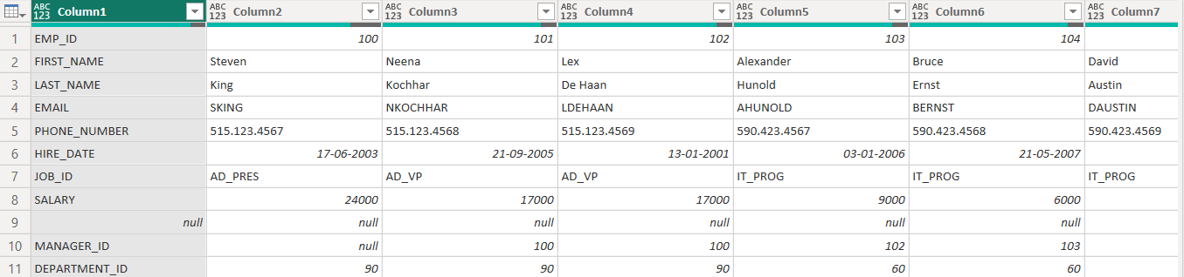
TRANSFORM
POWER QUERY EDITOR
TRANSFORM
TRANSPOSE
TREATING ROWS AS COLUMNS AND COLUMNS AS ROWS

Slide 26
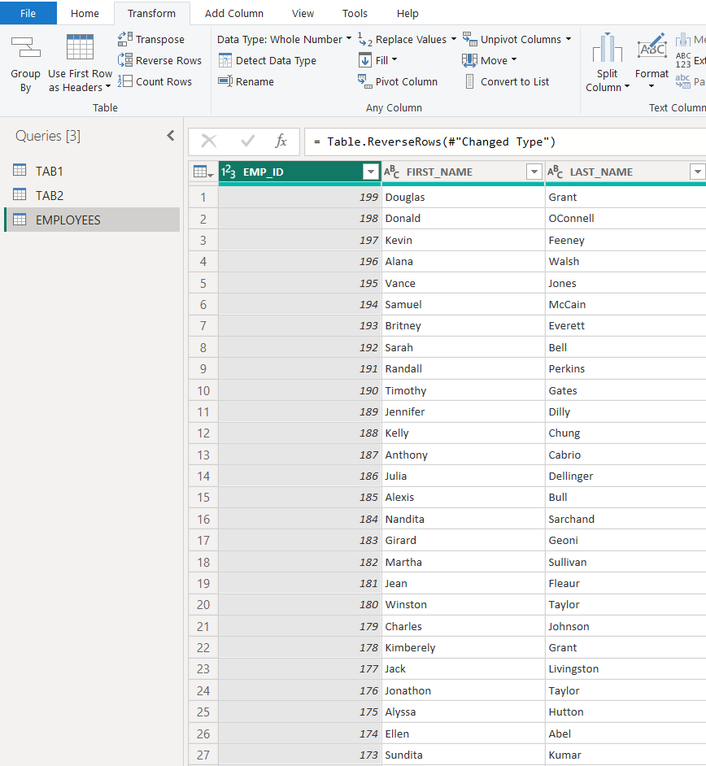
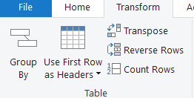
POWER QUERY EDITOR
TRANSFORM
REVERSE ROWS
SIMPLY FLIPS THE ORDER OF YOUR TABLE.
TURNING THE LAST ROW INTO THE FIRST AND THE FIRST ROW INTO THE LAST.
COUNT ROWS
SIMPLY GIVES THE COUNT OF THE ROWS PRESENT IN THE TABLE.

Slide 27
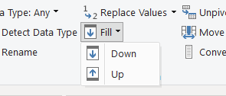
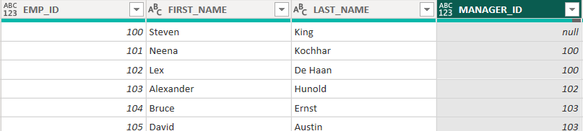
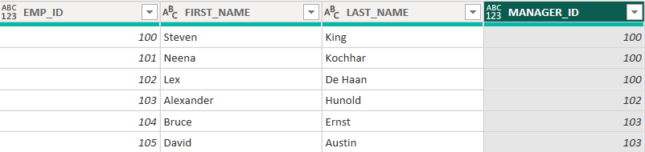
POWER QUERY EDITOR
TRANSFORM
FILL
DOWN : IT COPIES THE VALUE FROM ABOVE INTO THE EMPTY CELLS BELOW.
UP : : IT COPIES THE VALUE FROM BELOW INTO THE EMPTY CELLS ABOVE.

Slide 28
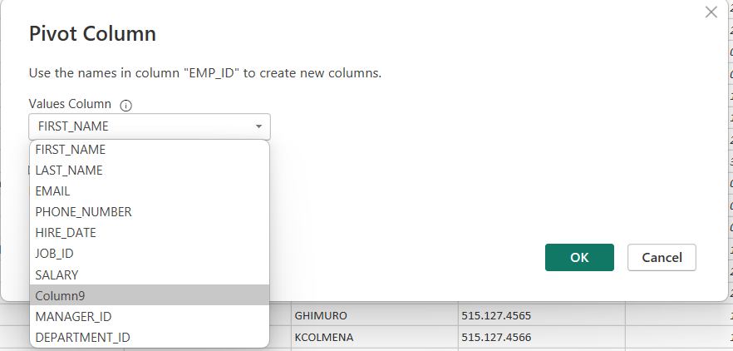
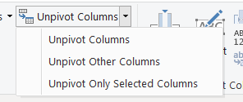
POWER QUERY EDITOR
TRANSFORM
PIVOT
IT IS USED TO TURN ROW VALUES INTO COLUMN HEADERS.
HELPING YOU RESHAPE YOUR DATA FOR ANALYSIS.
UNPIVOT COLUMNS
UNPIVOT COLUMNS : CONVERTS SELECTED COLUMNS INTO ROWS.
UNPIVOT OTHER COLUMNS : UNPIVOTS ALL COLUMNS EXCEPT THE ONES YOU SELECTED.
UNPIVOT ONLY SELECTED COLUMNS : KEEPS OTHER COLUMNS AS-IS AND ONLY UNPIVOTS WHAT YOU CHOOSE.

Slide 29
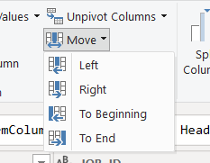
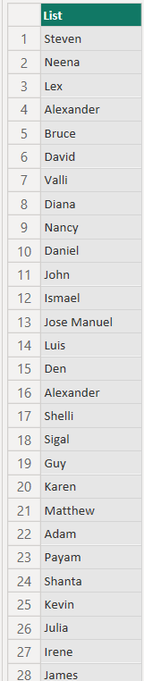
POWER QUERY EDITOR
TRANSFORM
MOVE
LEFT : SHIFTS THE COLUMN ONE PLACE TO THE LEFT
RIGHT : SHIFTS THE COLUMN ONE PLACE TO THE RIGHT
TO BEGINNING : SENDS THE COLUMN TO THE FIRST POSITION
TO END : SENDS THE COLUMN TO THE LAST POSITION.
LIST
IT TURNS SELECTED COLUMN INTO A LIST.

Slide 30
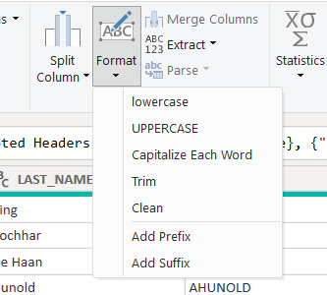
POWER QUERY EDITOR
TRANSFORM
FORMAT
LOWERCASE : MAKE ALL LETTERS IN LOWERCASE
UPPERCASE : MAKE ALL LETTERS IN UPPERCASE
CAPITALIZE EACH WORD : MAKE FIRST LETTER OF EACH WORD IN UPPERCASE
TRIM : REMOVES WHITESPACES AT THE BEGINNING AND END
CLEAN : REMOVES UNSEEN/ODD CHARACTERS(LIKE TABS OR LINE BREAKS)
ADD PREFIX : ADD TEXT BEFORE EACH VALUE (FOR EXAMPLE : “123” -> “ID_123”)
ADD SUFFIX : ADD TEXT AFTER EACH VALUE (FOR EXAMPLE : “123” -> “123_DONE”)

Slide 31
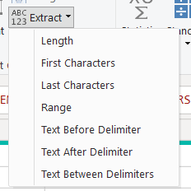
POWER QUERY EDITOR
TRANSFORM
EXTRACT
LENGTH : GIVES THE LENGTH OF THE STRING.
FIRST CHARACTERS : GETS THE FIRST FEW CHARACTERS. EXAMPLE ”LONDON” -> “LO”(IF YOU CHOOSE TWO CHARACTERS)
LAST CHARACTERS : GETS THE FIRST FEW CHARACTERS. EXAMPLE ”LONDON” -> “ON”(IF YOU CHOOSE TWO CHARACTERS)
RANGE : PICKS LETTERS STARTING AT A CERTAIN POSITION. EXAMPLE “ABCDEF” -> “CD”(STARTING AT POSITION 3 GET 2 CHARACTERS)
TEXT BEFORE DELIMITER : TAKES EVERYTHING BEFORE A CERTAIN SYMBOL. EXAMPLE “JOHN-SMITH ” -> “JOHN”
TEXT AFTER DELIMITER : TAKES EVERYTHING AFTER A CERTAIN SYMBOL. EXAMPLE “JOHN-SMITH ” -> “SMITH”
TEXT BETWEEN DELIMITERS : GRABS THE PART BETWEEN TWO SYMBOLS. EXAMPLE “ABC_123_D” -> “123”

Slide 32
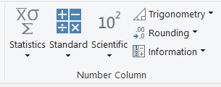





POWER QUERY EDITOR
TRANSFORM

Slide 33


POWER QUERY EDITOR
ADD COLUMN
CONDITIONAL COLUMN
IN THIS TAB YOU CAN GIVE A IF-ELSE CONDITION BASED ON THE COLUMN.
YOU CAN GIVE MULTIPLE IF CONDITIONS.
IT ADD COLUMN TO SHOW THE RESULT OF IF-ELSE CONDITION.

Slide 34


POWER QUERY EDITOR
ADD COLUMN
INDEX COLUMN
IT CREATE NEW COLUMN THAT GIVES A UNIQUE NUMBER TO EACH ROW i.e. PRIMARY KEY.
IT HELPS YOU IDENTIFY AND SORT ROWS EASILY.
DUPLICATE COLUMN
IT CREATE A NEW COLUMN THAT DUPLICATES THE VALUES IN THE CURRENTLY SELECTED COLUMN

Slide 35

POWER QUERY EDITOR
VIEW
FORMULA BAR : IT SHOWS YOU M QUERY FOR THE STEPS YOU’RE WORKING.
MONOSPACED : IT IS A TYPE OF TEXT WHERE EVERY LETTER AND NUMBER TAKES UP THE SAME AMOUNT OF SPACE.
SHOW WHITESPACE : IT HELPS YOU TO SHOW AND DETECT WHITESPACES.

Slide 36



COLUMN QUALITY : IT SHOWS YOU HOW GOOD YOUR DATA IS BY TELLING YOU THE PERCENTAGE OF VALID , ERROR , EMPTY(NULL) VALUES IN EACH COLUMN.
COLUMN DISTRIBUTION : IT SHOWS A SMALL CHART THAT HELPS YOU TO SEE HOW MANY UNIQUE AND DISTINCT VALUES ARE THERE IN THE COLUMN.
COLUMN PROFILE : IT GIVES A DETAILED SUMMARY OF A COLUMN.
POWER QUERY EDITOR
VIEW

Slide 37
Model Building Phase
MODEL BUILDING PHASE
DATA MODELING MEANS ORGANIZING YOUR DATA INTO TABLES AND CONNECTING THEM SO POWER BI CAN UNDERSTAND HOW THEY RELATE AND WORK TOGETHER FOR BUILDING REPORTS.
THERE ARE TWO TYPES OF TABLES INCLUDED IN MODEL BUILDING PHASE :
1) FACT TABLE
2) DIMENSION TABLE

Slide 38
Model Building Phase
FACT TABLE
A FACT TABLE IS THE CENTRAL TABLE IN A DATA MODEL THAT CONTAINS MEASURABLE , QUANTITATIVE DATA.
A FACT TABLE STORES NUMBERS OR CALCULATIONS – LIKE SALES , PROFIT OR QUANTITY.
FACT TABLE CONTAINS FOREIGN KEYS THAT CONNECT TO THE DIMENSION TABLES.
THERE IS ONLY ONE FACT TABLE CONNECTED TO THE MULTIPLE DIMENSION TABLES.

Slide 39
Model Building Phase
2) DIMENSION TABLES
A DIMENSION TABLE PROVIDES CONTEXT OR DESCRIPTIVE INFORMATION ABOUT THE FACTS.
IT STORES DETAILS LIKE PRODUCT NAME , CUSTOMER NAME CATEGORY, etc .
DIMENSION TABLE CONTAINS PRIMARY KEYS THAT CONNECT TO THE FACT TABLE.
MULTIPLE DIMENSION TABLES CONNECTED TO THE ONLY ONE FACT TABLE.
DIMENSION TABLE FILTERING FACT TABLE.

Slide 40
TYPES OF RELATIONSHIPS
THERE ARE BASICALLY FOUR TYPES OF RELATIONSHIP
CALLED CARDINALITY RATIO
ONE-TO-MANY(1 : *)
ONE VALUE IN THE DIMENSION TABLE RELATES TO MANY IN THE FACT TABLE.
EXAMPLE : ONE PRODUCT -> MANY SALES
2) MANY-TO-ONE (* : 1)
SAME AS 1: * BUT IN REVERSED DIRECTION.
3) MANY-TO-MANY (* : *)
BOTH TABLES HAVE REPEATED VALUES.
EXAMPLE : STUDENTS AND COURSES(STUDENT CAN TAKE MANY COURSES , COURSES HAVE MANY STUDENTS).
4) ONE-TO-ONE (1 : 1)
ONE VALUE IN ONE TABLE MATCHES EXACTLY ONE IN ANOTHER.
Model Building Phase

Slide 41
TYPES OF SCHEMAS
FLAT SCHEMA
A Flat Schema is a simplest type where all data is stored in a single table.
It is also called Denormalized Schema.
No relationship with other tables.
Useful for small datasets and quick reports are needed.
Model Building Phase

Slide 42

TYPES OF SCHEMAS
STAR SCHEMA
One central fact table connected to multiple dimension tables.
It has less number of foreign keys and joins.
Performance is faster and easy to understand.
Model Building Phase

Slide 43

TYPES OF SCHEMAS
SNOWFLAKE SCHEMA
Fact table is at center surrounded with multiple dimension tables and dimension table also connected to sub-dimension table.
It is most normalized schema.
It takes more time for query execution than star schema
Model Building Phase

Slide 44
ROLE PLAYING DIMENSION TABLE
We can pass only one active relationship between two tables.
If you want to make inactive relation to active relation then role playing dimension table concept is used.
Model Building Phase

Slide 45
CONNECTIVITY MODES IN POWER BI
IMPORT MODE
Power Bi imports the data from your local computer.
Maximum limit from importing data is 1 GB.
It gives access permission for table view , report view and model view.
Advantages-
High performance
Efficient way of connectivity
High retrieving rate
Model Building Phase

Slide 46
CONNECTIVITY MODES IN POWER BI
DIRECT QUERY
No data is imported.
Power BI queries the source live every time a user interacts.
Table View is unavailable.
Can’t create calculated columns.
Some DAX functions are not supported.
Model Building Phase

Slide 47
CONNECTIVITY MODES IN POWER BI
LIVE CONNECTION
It is similar to direct queries.
Power BI connects directly to an existing data model and does not copy or store any data in your file.
You can not add new data tables or do heavy modeling in your file.
Only report view is visible
It is only used for visualization.
Model Building Phase

Slide 48
DATA ENHANCEMENT PHASE
Data enhancement sometimes called data enrichment is the process of improving data quality.
In this , we are calculating new fields so it becomes more complete , more valuable , and easier to analyze.
To enrich your data you can use DAX query.
DAX stands for Data Analysis Expressions. It is a formula language used in Power BI.
DAX is not Case – Sensitive.

Slide 49
Calculated Column | Calculated Measure
It works on each row | It works on aggregated result(like total)
In this we provide one input and we get row by row output. | In measure we provides many inputs but we get only one output.
We can do all operations and it works with more than one attributes. | Used only for aggregate functions like count and it work with only one attribute.
Not Dynamic | Fully Dynamic

Slide 50

DATE AND TIME FUNCTION
WEEKDAY : Returns a number from 1 to 7 identifying the day of the week of a date. By default the day ranges from 1 (Sunday) to 7 (Saturday).
EDATE : Returns the date that is the indicated number of months before or after the start date.
DATEDFF : Returns the number of interval boundaries between two dates.
DAX
FUNCTIONS

Slide 51
EOMONTH : Returns the date in datetime format of the last day of the month, before or after a specified number of months.
TODAY : Returns the current date.
DAX
FUNCTIONS

Slide 52

TEXT FUNCTION
FORMAT : Converts a value to text according to the specified format.
COMBINEVALUES : Joins two or more text strings into one text string.
CONCATENATE : Joins two text strings into one text string.
DAX
FUNCTIONS

Slide 53

DAX
FUNCTIONS
LEFT : Returns the specified number of characters from the start of a text string.
RIGHT : RIGHT returns the last character or characters in a text string, based on the number of characters you specify.
FIND : Returns the starting position of one text string within another text string. FIND is case-sensitive.

Slide 54



DAX
FUNCTIONS
SEARCH : Returns the starting position of one text string within another text string. FIND is case-insensitive.
LEN : Returns the number of characters in a string.
MID : Extracts the part of the text from the middle , starting at a position you choose.

Slide 55



LOGICAL FUNCTIONS
IF : Check the condition –if it is true ,do one thing and if it is false ,do something else.
AND : It returns true only if both conditions are true.
OR : Returns true if any one of the condition is true.
DAX
FUNCTIONS

Slide 56


DAX
FUNCTIONS
SWITCH : Similar to a case statement – checks a value and returns different results based on matching cases.
IFERROR : Catches errors and replaces them with a friendly value.

Slide 57


RELATIONSHIP FUNCTIONS
RELATED : Pull a column value from a related table using a relationship.
RELATEDTABLE : Get the related rows from another table as a table object, not a single value.
DAX
FUNCTIONS

Slide 58


FILTER FUNCTIONS
CALCULATE : Changes the context of a calculation.
FILTER : Returns a table with only the rows that match a condition. Used mostly inside a calculate.
DAX
FUNCTIONS

Slide 59


DAX
FUNCTIONS
ALL : Removes filters from a column or table. Useful when you want to calculate totals ignoring filters.
LOOKUPVALUE : Returns a single value by searching in another table.

Slide 60


INFORMATION FUNCTIONS
ISBLANK : Check if a value is blank.
ISFILTERED : Checks if a column is currently being filtered in a report.
DAX
FUNCTIONS

Slide 61

TIME INTELLIGENCE FUNCTIONS
TOTAL YTD : Calculates the total from the start of the year to the selected date.
TOTAL QTD : Calculates the total from the start of the quarter to the selected date.
TOTAL MTD : Calculates the total from the start of the month to the selected date.
DAX
FUNCTIONS

Slide 62
PREVIOUS YEAR : Returns the same period from the last year.
PREVIOUS QUARTER : Returns the same period from the last quarter.
PREVIOUS MONTH : Returns the same period from the last month.
PREVIOUS DAY : Returns the same period from the last day.
DAX
FUNCTIONS

Slide 63

DAX
FUNCTIONS
NEXT DAY , NEXT MONTH : Returns the next day or period after the current one in your date table. You use them inside CALCULATE to find future values like sales of the next day , sales of the next month.

Slide 64


DAX
FUNCTIONS
SELECTEDVALUE : SELECTEDVALUE gives you the value selected by the user. Usually from a slicer , filter, or visual.

Slide 65
Visualization
VISUALIZATION
Virtualization in Power BI refers to how data is visually represented in reports without necessarily loading or duplicating all of it. It allows you to create visuals and interact with large datasets efficiently.
It means showing only the data you need in visuals (like graphs, charts), without loading the full dataset at once. This makes reports faster and more efficient.

Slide 66

Visualization
Donut Chart
A donut chart displays data in a circular shape, where each slice shows a percentage or value of a category compared to the whole.
Shows Sales by country in Donut Chart

Slide 67

Visualization
Bookmark
Bookmark is a feature that lets you save the current view of your report page(including filters, slicers, visuals and visibility). You can go back to this saved view by clicking the bookmark.
A bookmark saves the look and state of your report(like a screenshot with functionality) so you can return to it anytime with a click.

Slide 68
Visualization
DRILL THROUGH
Drill through in Power BI allows you to right-click on data point in one visual and navigate to another page that shows detailed information(drilled down data) related only to that point.
Drill Through filters pass data from one visual/report page to another, based on a selected field.
If I click on Year, you will see the following bar chart of revenue by year. Same when I click on Quarter or day, the visual changes.

Slide 69
POWER BI SERVICE
Presented by : Tanaya Narvekar

Slide 70

INTRODUCTION
POWER BI SERVICE is a cloud-based business analytics and data visualization service that enables anyone to visualize and analyse data with greater speed, efficiency and understanding.
Power BI Service = Online platform to view, share, refresh, and collaborate on Power BI reports and dashboards.

Slide 71
Difference Between POWER BI DESKTOP AND POWER BI SERVICE
POWER BI SERVICE
POWER BI DESKTOP | POWER BI SERVICE
It is free of cost. Installed on your computer (Windows) | It is paid. Cloud-based (access through web browser)
Manual refresh only | Automatic (scheduled) data refresh available
Reports cannot share directly | Share reports and dashboards with end users
Used for create, design, and develop reports | Used for share, view, and collaborate on reports and dashboards

Slide 72
POWER BI SERVICE
TYPES OF POWER BI SERVICES LICENSES
POWER BI PRO
POWER BI PER USER
POWER BI PREMIUM PER CAPACITY

Slide 73
POWER BI PRO
Model Limit is of 1 GB
Refresh rate 8/Day
If user sending by pro then the receiver also must have the pro version
Storage Capacity is 10 GB/User
POWER BI SERVICE

Slide 74
POWER BI PER USER
Model Limit is of 100 GB
Refresh rate 48/Day
If user sending by per then the receiver also must have the per user version
Storage Capacity is 100 TB/User
POWER BI SERVICE

Slide 75
POWER BI PREMIUM PER CAPACITY
Model Limit is of 400 GB
Refresh rate 48/Day
If user sending by per capacity then there is no such condition for receiver
Storage Capacity is 100 TB/User
POWER BI SERVICE

Slide 76

POWER BI SERVICE
WORKSPACES
Workspace is a shared environment for a group of people . You can have multiple Power BI content in a workspace.
One Workspace have hundreds of dashboards, reports and datasets in it.
You can add people (or Power BI account in other words) to the workspace and give them access to edit or read the content.
We can create only one app per workspace.

Slide 77
POWER BI SERVICE
Difference Between MY WORKSPACE And USER WORKSPACE
My Workspace is a personal workspace for any Power BI customer to work with your own content. Only you have access to your my workspace. You can share dashboards and reports from your my workspace.
Workspaces are used to collaborate and share content with colleagues. You can add colleagues to your workspaces and collaborate on dashboards, reports, workbooks and datasets. With one exception , each workspace member needs a Power BI Pro or Premium Per User(PPU) license.

Slide 78

WORKSPACE CREATION
POWER BI SERVICE

Slide 79

WORKSPACE CREATION
POWER BI SERVICE

Slide 80
Report : A report is an interactive visualization created from data.
Semantic Model (Dataset) : It is structured data model with tables, relationships and measures used to built reports.
POWER BI SERVICE

Slide 81
POWER BI SERVICE
Roles To Handle Workspaces
Go To Manage Access -> Add People
Admin : Full Control(add/remove users, publish, update, delete, content).
Member : Can edit, publish and schedule refreshes.
Contributor : Can publish content but can’t update/delete reports or manage permissions.
Viewer : Can view content, can’t make any changes.

Slide 82


DASHBOARD
A dashboard in Power BI service is a single-page, interactive canvas with visuals(tiles) from one or more reports or datasets.
With the use of Dashboard we can overview important visuals on one page.
POWER BI SERVICE

Slide 83
POWER BI SERVICE
ROW LEVEL SECURITY
Row-Level Security showing only specific rows of data to each user based on rules you set.
There are two types of Row-Level Security :
Static Row-Level Security
Dynamic Row-Level Security

Slide 84


How To Create Static RLS
In Power BI desktop
Sales Data By Country
Modeling -> Manage Roles
POWER BI SERVICE

Slide 85

How To Create Static RLS
POWER BI SERVICE

Slide 86


How To Create Static RLS
Click On View As Role and Click On RLS
It shows Sales by Country for Canada Only.
POWER BI SERVICE

Slide 87

DEPLOYMENT PIPELINE
Deployment Pipeline is a feature that helps you manage and move reports from development to production in a structured way.
Deployment Pipeline has three stages :
POWER BI SERVICE

Slide 88
THANK YOU

